Slide 1
Trend Event Pattern Mining
Talha Farhat
Abdul Hadi

Slide 2
Overview
Overview
1. Problem Statement
2. Introduction
3. Methodology
4. Results
5. Demo
6. Future Work

Slide 3
Problem Statement
Develop a trend-event pattern mining framework that can aid in personalized treatment/prognosis.

Slide 4
Introduction
Objective: Develop a trend-event pattern mining framework that aids in personalized treatments based on patient data.
Focus: Analyze vital signs and medication events to derive insights for prognosis models.
Data Sources: Electronic Health Records (EHR) data including vitals, medications, and lab results.

Slide 5
Methodology

Slide 6
ETL

Slide 7
ETL Process
The first step
Initial problem was loading all the patients info at once
Led to memory error
Solution: load data by converting it into chunks using pandas and save it as a csv
Saves the trouble of accessing mongo server time and again

Slide 8
Data Cleaning

Slide 9
Data Cleaning
Standardizing vitals data:
BMI was miscalculated due to some height and weight readings being taken in pounds and inches
Converted these to SI Units by observing abnormal values in the BMI column
Cleaned Mean Arterial Pressure by clipping values on 3 IQR based on consultation with doctor

Slide 10
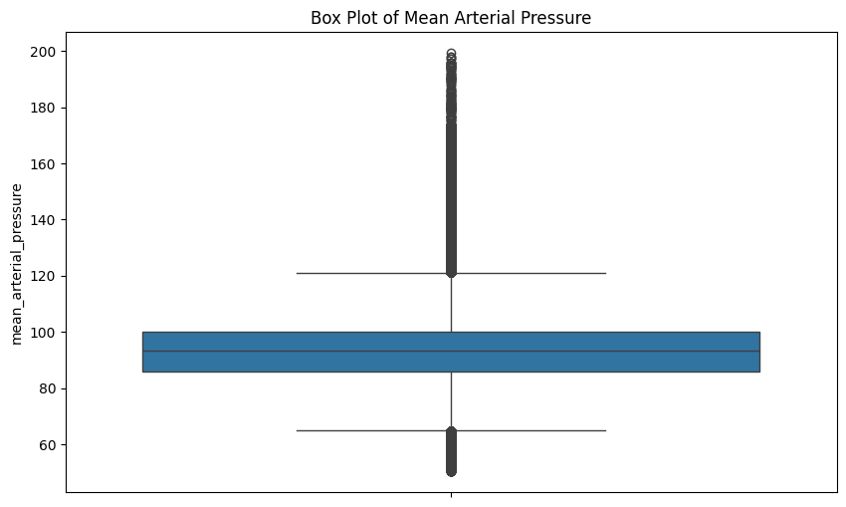
Clipping Outliers

Slide 11
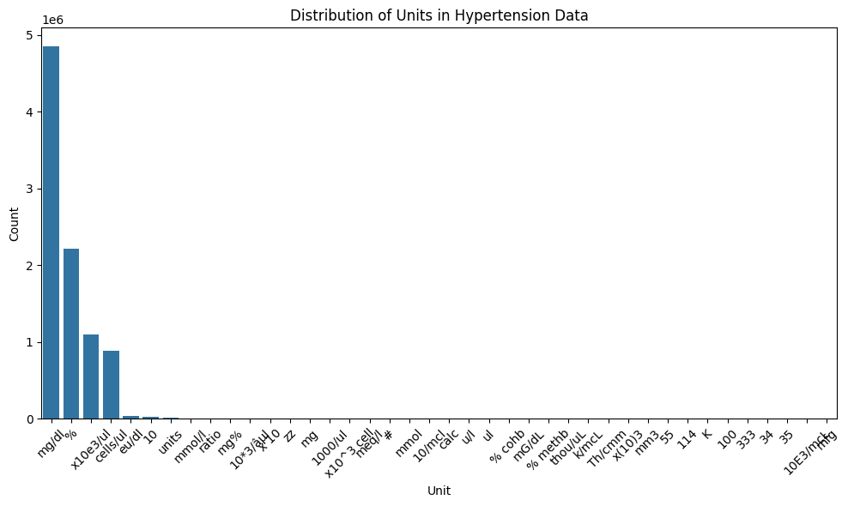
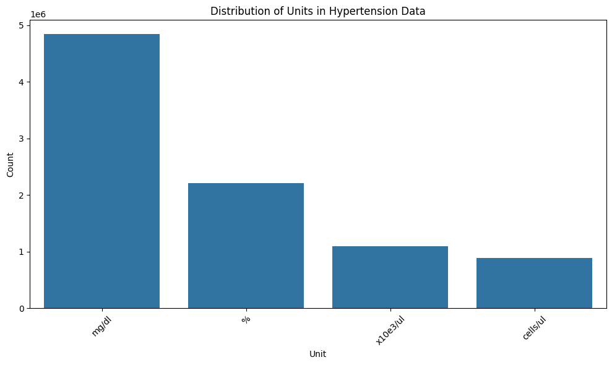
Standardization of units for Labs
Units of Extracted Labs Before Cleaning
Units of Extracted Labs After Cleaning

Slide 12
Tuple Extraction

Slide 13
Tuple Extraction
The extracted vitals and medications df are used in unison
We find the latest lab/vital reading for each patient.
Then we find the lab reading that immediately precedes the latest one.
If found, look for medication prescribed in between.
Final Representation
(patient_ID,
measured_metric_name,
Days Before,
Value_before_mediation,
Med_GPI_Code,
Days After medication,
Value_after_medication)
Example
(1234,MAP,182,5.4,39400000,18,6.7)

Slide 14
Abstraction

Slide 15
Abstraction : Idea
EHR is noisy and inconsistent
Common idea persistent in literature is to abstract values into categories so that noisiness can be overlooked
Two types of abstraction is common:
Vital /Lab Value Categorization
Temporal Abstraction

Slide 16
Value Categorization

Slide 17
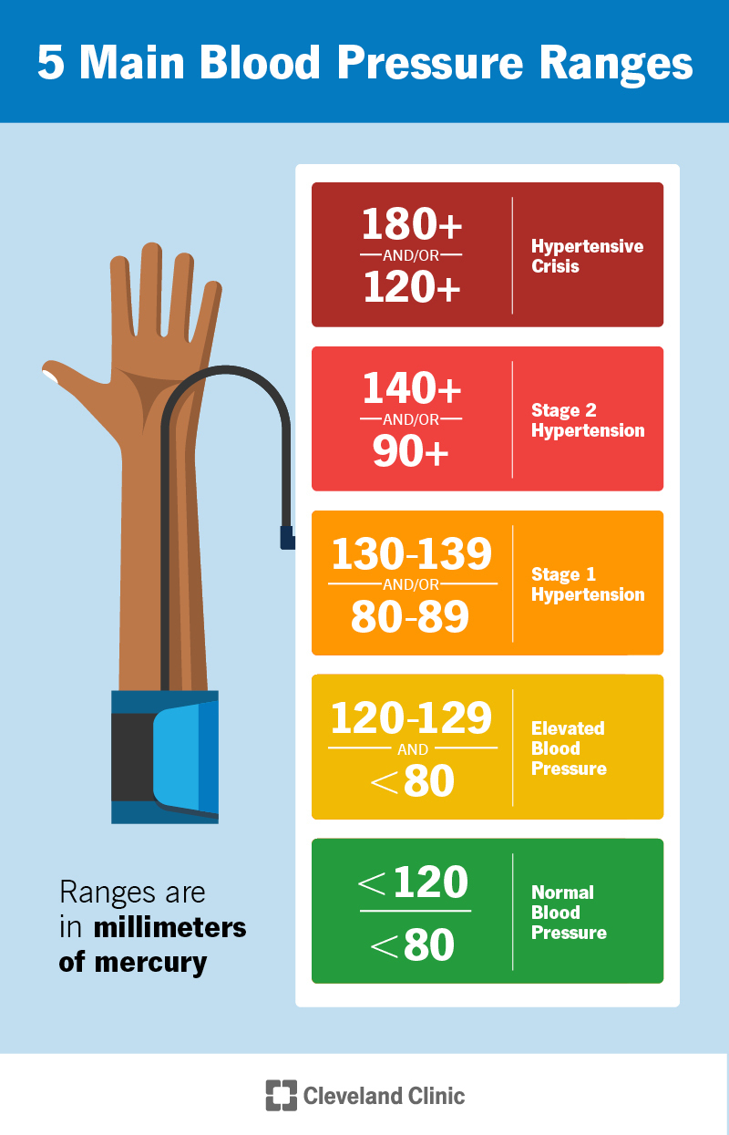
Observed Metric Abstraction
Classify Values into Categories using defined ranges in medical domain knowledge
The categories for each different lab/vitals were verified by doctors

Slide 18
Temporal Abstraction

Slide 19
Temporal Abstraction : Idea
Readings that occur closer to the medication event provide stronger support for identifying the underlying trend.
Quantify the recency of observed metric based on the above hypothesis

Slide 20
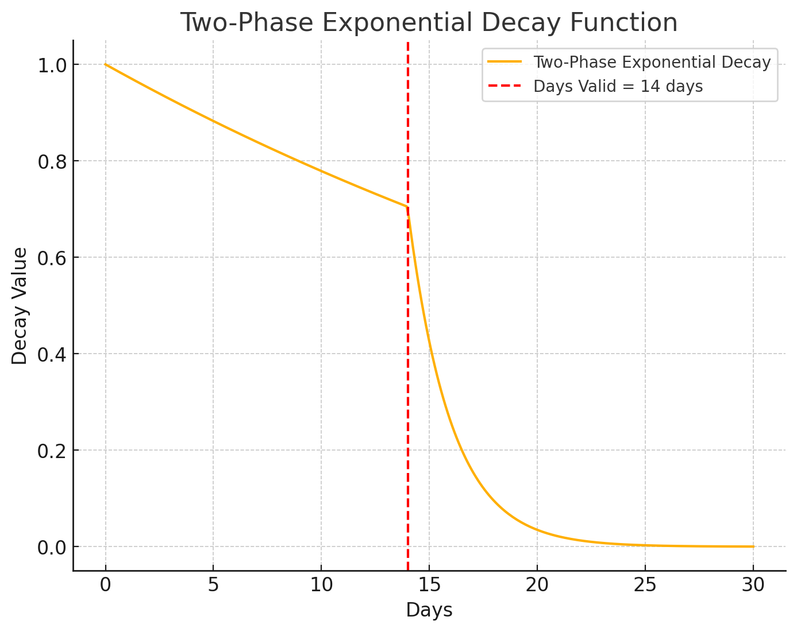
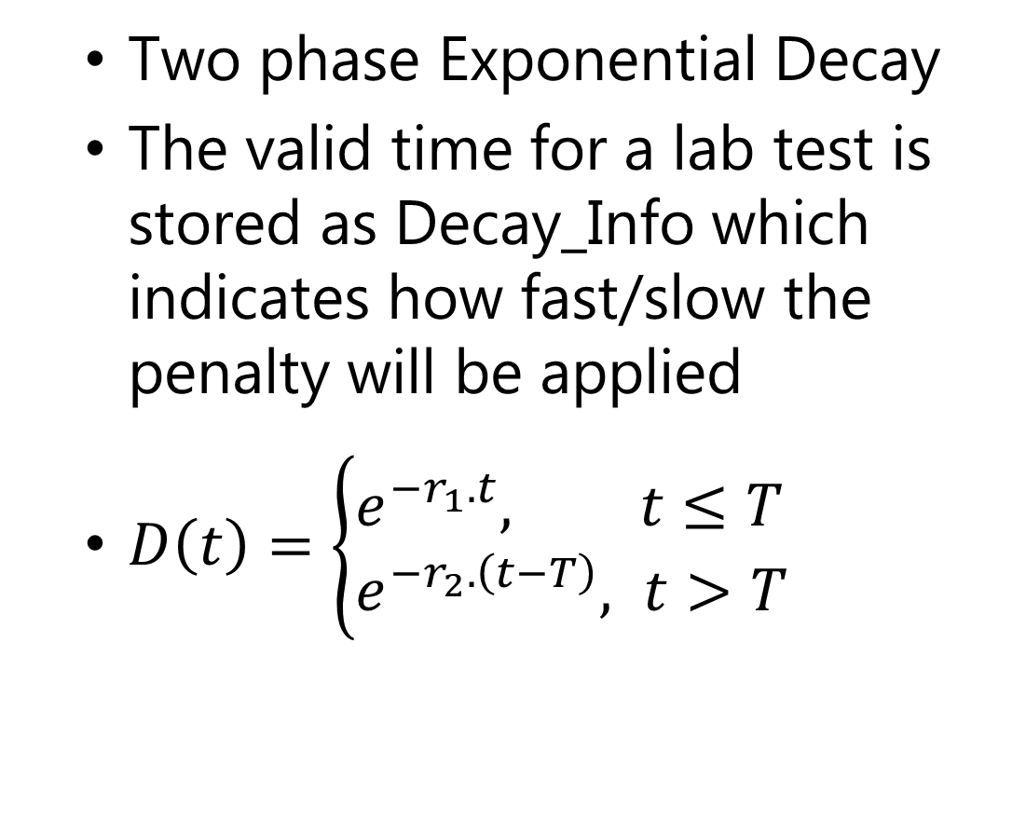
Penalty Based on Recency
Two phase Exponential Decay
The valid time for a lab test is stored as Decay_Info which indicates how fast/slow the penalty will be applied
$D\left(t\right)=\left\{\begin{aligned}&e^{−r_{1}.t}, t≤T \\ &e^{−r_{2}.\left(t−T\right)}, t>T\end{aligned}\right.$

Slide 21
Temporal Abstraction : Categorization
Approach 1
Apply penalties and bin the outcomes based on their values
Bin values (0-0.3), (0.3-0.6), (0.6-1.0)
Fault
not interpretable
Too many Categories after Grouping

Slide 22
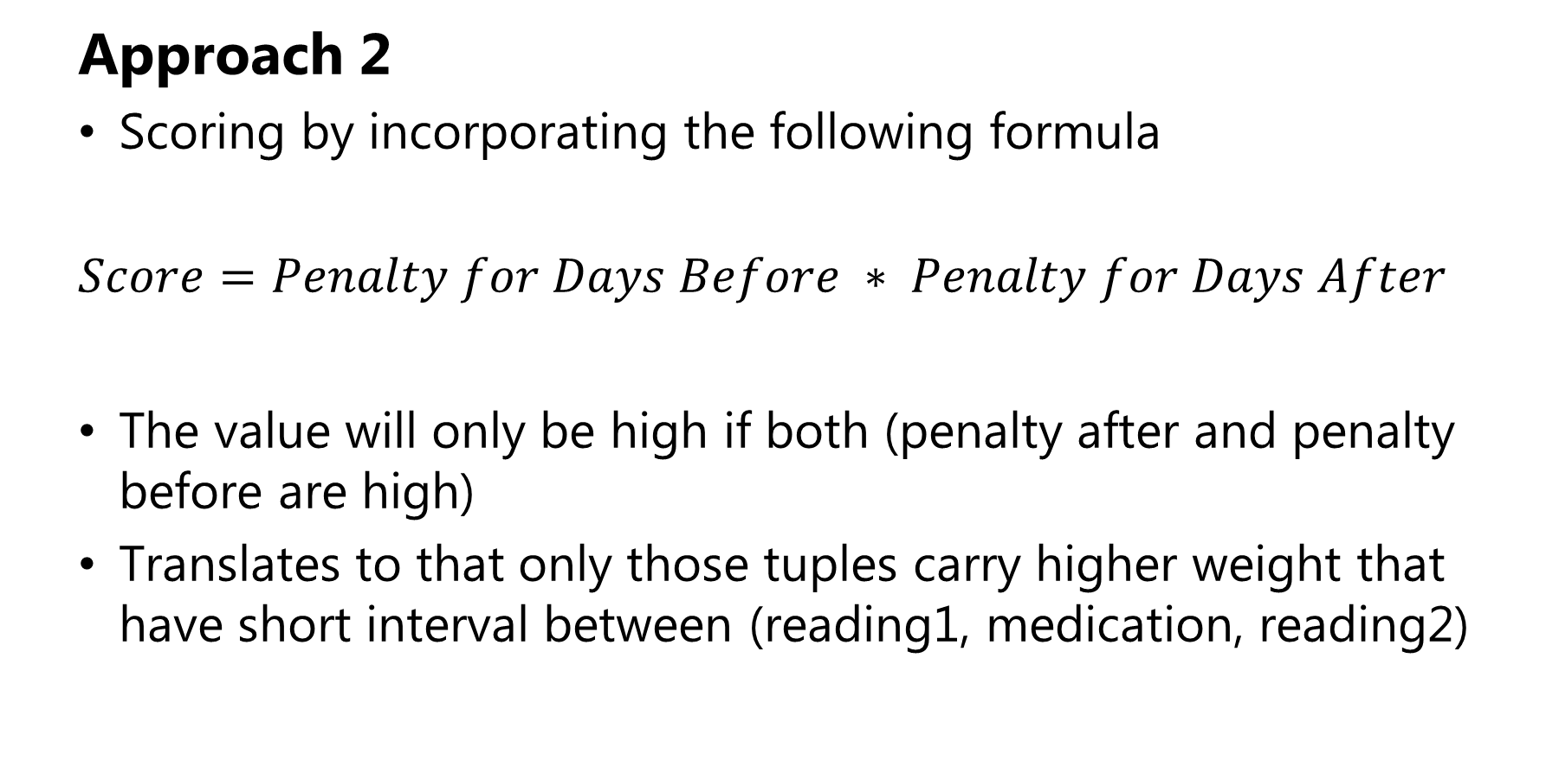
Temporal Abstraction : Idea
Approach 2
Scoring by incorporating the following formula
$$Score=Penalty for Days Before ∗ Penalty for Days After$$
The value will only be high if both (penalty after and penalty before are high)
Translates to that only those tuples carry higher weight that have short interval between (reading1, medication, reading2)

Slide 23
Grouping Based on Trends

Slide 24
Grouping on Trends
All the extracted and categorized results are finally grouped to view the desired Patterns
The extracted dataframe is grouped by GPI_CODE,Cat_Before and Cat_After.

Slide 25
Grouping on Trends
Aggregation of the penalty scores is done by adding all the scores together that fall under the grouping done above.
Another column, Count, depicting the total observed occurrences of the grouping is added as a support for the observed score.

Slide 26

Grouping on Trends
Finally the aggregated scores for each grouped trend is normalized according to the formula :
$$\frac{Score\left(Cat_After \right|Cat_Before)}{\sum{Score(Cat_Before)}}$$

Slide 27
Explainability

Slide 28
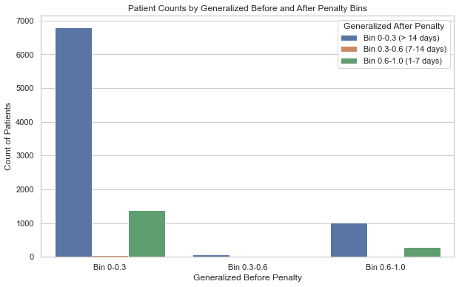
Grouping on Trends
The process of abstractions has the downfall of losing explainability
This aspect is catered for allowing the doctor to see a detailed view of the patient cohort that led to the score of each tuple

Slide 29
Results

Slide 30
Hypertension Results
For detailed analysis, we focused on Mean Arterial Pressure of Patients Diagnosed with Hypertension
Total number of patients present : 450 K
No. of valid tuples extracted : 3.3 M
After Grouping based on Trends : 22 K

Slide 31
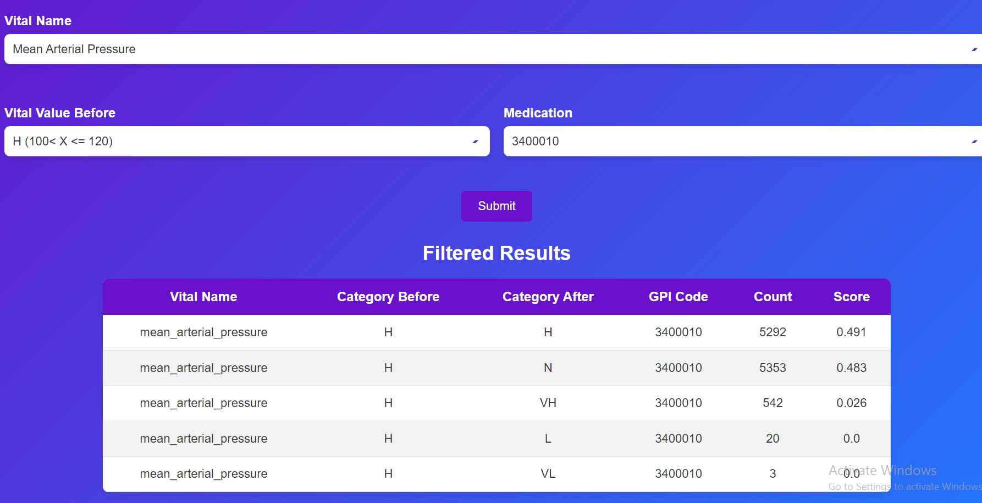
Hypertension Results
39400010 medicine helped lower the mean arterial pressure from High to Normal more than 5000 times.
3400 drug belongs to calcium blockers that help in stopping calcium from entering the blood vessels.

Slide 32
Results
Further detailed analysis for each disease can be conducted to verify the efficacy of each drug against the current condition of the patient

Slide 33
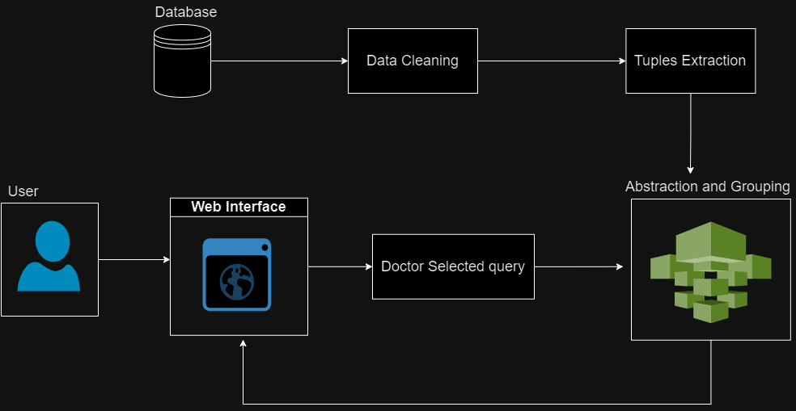
Architecture Diagram

Slide 34
Proposed Deployment Environment

Slide 35
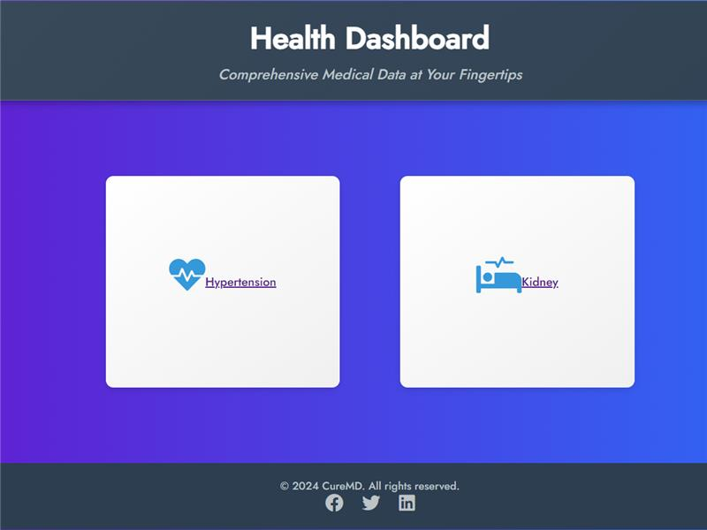
Doctor’s Dashboard

Slide 36
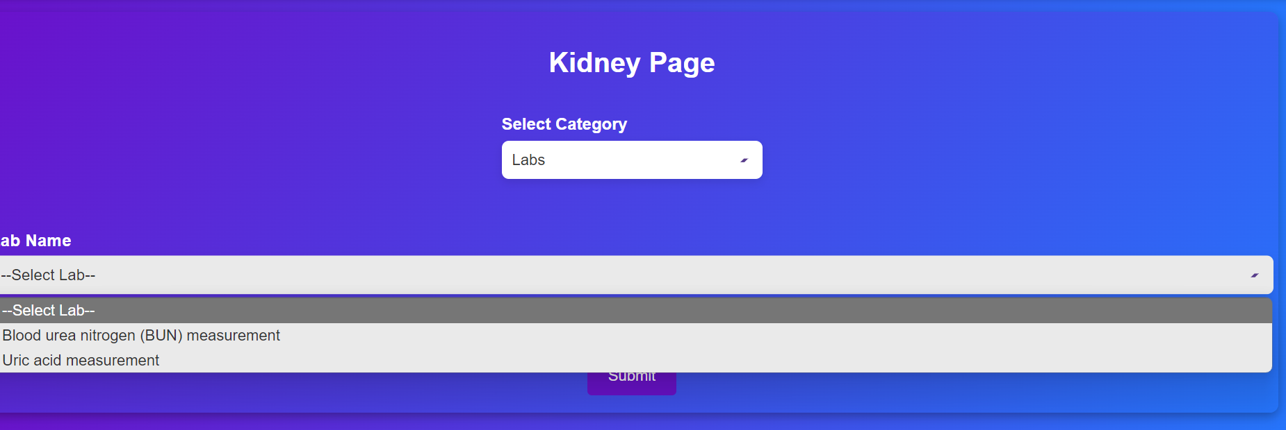
Doctor’s Dashboard

Slide 37
Doctor’s Dashboard

Slide 38
Triple Extraction Evaluation
Demo

Slide 39
Triple Extraction Evaluation
Future Work

Slide 40
Future Work
Get validation of the results from a doctor .
The extraction can be extended for all labs / vitals of common diseases for which EHR data is available

Slide 41
Thank You

